Slide 1
Discussion 8: More Asymptotics

Slide 2
Administrivia
Project 2 Phase 2 due March 5th
Labs this week will be Project 2 checkoff
Sign up here!
HWs 2 and 3 upcoming due 3/14 and 3/19
Midterm 2 far in the future 3/20

Slide 3
Notation: Big O, Big Omega, Big Theta
Goal: Look at program complexity for large input
Notations:
Big O - bounds above
Big Omega - bounds below
Big Theta - bounds above and below
Notes:
Introduce the 3 common ways of assessing runtime. We’ll go in more detail on the next couple slides.
It’s important here that students know to represent runtime as algebraic inputs like 6n^2 + 9 for example.

Slide 4
O (Big O)
Let f(n) and g(n) be positive real numbers on inputs of size n
f ∈ O(g) if there is a constant c > 0 s.t. f(n) <= c g(n)
Upper bounded by g(n) when n gets significantly large.
Bound does not have to be tight.
Notes:
Make sure students understand that big O is a worst case analysis of the program and is an upper bound on the runtime. Bound doesn’t have to be tight, meaning O(2^n) for an n^2 problem but generally, expect the tightest big O bound.

Slide 5
Ω (Big Omega)
Let f(n) and g(n) be positive real numbers on inputs of size n
f ∈ Ω(g) if there is a constant c > 0 s.t. f(n) >= c g(n)
Lower bounded by g(n) when n gets significantly large.
Bound does not have to be tight.
Notes:
Same idea, but with big omega

Slide 6
Θ (Big Theta)
Let f(n) and g(n) be positive real numbers on inputs of size n
f ∈ Θ(g) if there is a constant c1 > 0 and c2 > 0 s.t.
C1 g(n) <= f(n) <= c2 g(n) for all c1 <= c2
Tightly bounded by g(n) when n gets significantly large.
• f ∈ Ω(g) and f ∈ O(g)
Notes:
The important point here is big theta is just squeezing the runtime between big O and big Omega. It’s a tight bound so best and worst case. Always case.

Slide 7
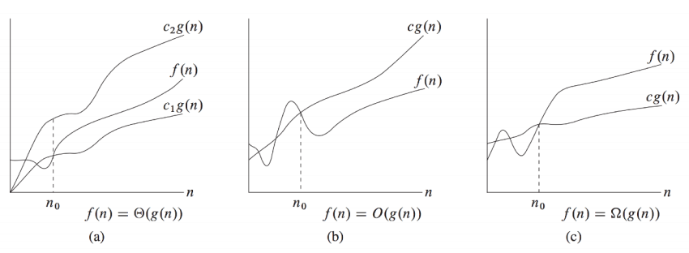
Introduction to Algorithms, Cormen, Leiserson, Rivest, Stein
Notes:
Good visual example. Important to note that for small inputs, bounds could be wrong but as n -> infinity, we see how the bounds.

Slide 8
Conventions: No Constants
Drop multiplicative constants and lower order terms
Any exponential dominates any polynomial
Any polynomial dominates any logarithm

Slide 9
Common Asymptotic Sets
O(1): constant
O(log n): logarithmic
O(sqrt(n)): square root
O(n): linear
O(n log n): linearithmic
O(n^2): quadratic
O(n^3): cubic
O(2^n): exponential
O(n!): factorial
Notes:
Good recap after the first problem.

Slide 10
Analyzing Runtime
# Let’s find out the big-O runtime of this wonderful sorting algorithm!
public int[] bogosort(int[] ints) {
while (!isSorted(ints)) {
Collections.shuffle(ints);
}
return ints;
}

Slide 11
Analyzing Runtime Example
# Let’s find out the big-O runtime of this wonderful sorting algorithm!
# We enter a while loop until the list is sorted, let’s assume that isSorted runs in O(n)
public int[] bogosort(int[] ints) {
while (!isSorted(ints)) {
Collections.shuffle(ints);
}
return ints;
}

Slide 12
Analyzing Runtime Example
# Let’s find out the big-O runtime of this wonderful sorting algorithm!
# We enter a while loop until the list is sorted, let’s assume that isSorted runs in O(n)
# At each iteration, we shuffle the ints. Let’s assume this can also be done in O(n)
# How many times will we run this while loop if we keep shuffling?
public int[] bogosort(int[] ints) {
while (!isSorted(ints)) {
Collections.shuffle(ints);
}
return ints;
}

Slide 13
Analyzing Runtime Example
# Let’s find out the big-O runtime of this wonderful sorting algorithm!
# We enter a while loop until the list is sorted, let’s assume that isSorted runs in O(n)
# At each iteration, we shuffle the ints. Let’s assume this can also be done in O(n)
# Since there are n! possible arrangements of ints, we have a 1/n! chance to correctly sort on a shuffle.
public int[] bogosort(int[] ints) {
while (!isSorted(ints)) {
Collections.shuffle(ints);
}
return ints;
}

Slide 14
Analyzing Runtime Example
# Let’s find out the big-O runtime of this wonderful sorting algorithm!
# We enter a while loop until the list is sorted, let’s assume that isSorted runs in O(n)
# At each iteration, we shuffle the ints. Let’s assume this can also be done in O(n)
# Since there are n! possible arrangements of ints, we have a 1/n! chance to correctly sort on a shuffle.
# The while loop dominates the runtime, taking n time to shuffle and n! potential iterations in expection.
# O(n * n!) in expectation.
# Unbounded in the worst case.
public int[] bogosort(int[] ints) {
while (!isSorted(ints)) {
Collections.shuffle(ints);
}
return ints;
}

Slide 15
Techniques for Analyzing Runtime
Annotate your code
Write down runtimes of called functions
Consider end conditions for loops and consequently the number of times we could run the loop
What are the terminating conditions for a loop?
Can we algebraically express the runtime of the loop?
Branching factor
Do we make additional calls and if so, how many subproblems do we make?

Slide 16
Analyzing Runtime Example 2
# Let’s find out the big-O runtime of this algorithm!
public void doStuff(int n) {
int i = 2;
while (i <= n) {
i = Math.pow(i, 2);
}
}

Slide 17
Analyzing Runtime Example 2
# Let’s find out the big-O runtime of this algorithm!
# We initialize i = 2 and run the loop until i <= n
public void doStuff(int n) {
int i = 2;
while (i <= n) {
i = Math.pow(i, 2);
}
}

Slide 18
Analyzing Runtime Example 2
# Let’s find out the big-O runtime of this algorithm!
# We initialize i = 2 and run the loop until i <= n
# At each iteration of the while loop, we square i
# i = i^2
public void doStuff(int n) {
int i = 2;
while (i <= n) {
i = Math.pow(i, 2);
}
}

Slide 19
Analyzing Runtime Example 2
# Let’s find out the big-O runtime of this algorithm!
# We initialize i = 2 and run the loop until i <= n
# At each iteration of the while loop, we square i
# i = i^2
# Let’s try to generalize this. After a lot of iterations, we get something that looks like this: i^2^2^2^2…
# How can we write this algebraically? .
public void doStuff(int n) {
int i = 2;
while (i <= n) {
i = Math.pow(i, 2);
}
}

Slide 20
Analyzing Runtime Example 2
# Let’s find out the big-O runtime of this algorithm!
# We initialize i = 2 and run the loop until i <= n
# At each iteration of the while loop, we square i
# i = i^2
# Let’s try to generalize this. After a lot of iterations, we get something that looks like this: i^2^2^2^2…
# i^(2^2^2^2…) = i^(2^k) <= n where k is our number of iterations
public void doStuff(int n) {
int i = 2;
while (i <= n) {
i = Math.pow(i, 2);
}
}

Slide 21
Analyzing Runtime Example 2
# Let’s find out the big-O runtime of this algorithm!
# We initialize i = 2 and run the loop until i <= n
# At each iteration of the while loop, we square i
# i = i^2
# Let’s try to generalize this. After a lot of iterations, we get something that looks like this: i^2^2^2^2…
# i^(2^2^2^2…) = i^2^k <= n where k is our number of iterations and we know i starts at 2
# Let’s solve for k: log(log(2^2^k) <= log(log(n))
# k <= log(log(n)) -> O(log(log(n)))
public void doStuff(int n) {
int i = 2;
while (i <= n) {
i = Math.pow(i, 2);
}
}

Slide 22
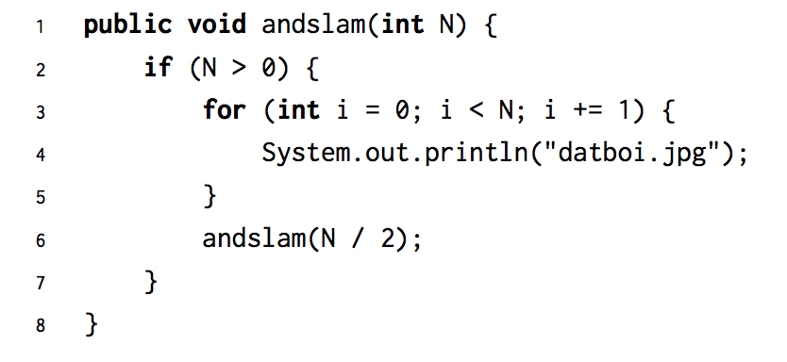
Problem 1.1

Slide 23
Problem 1.1
Θ(N)
Log n levels of work and each level is O(n)

Slide 24
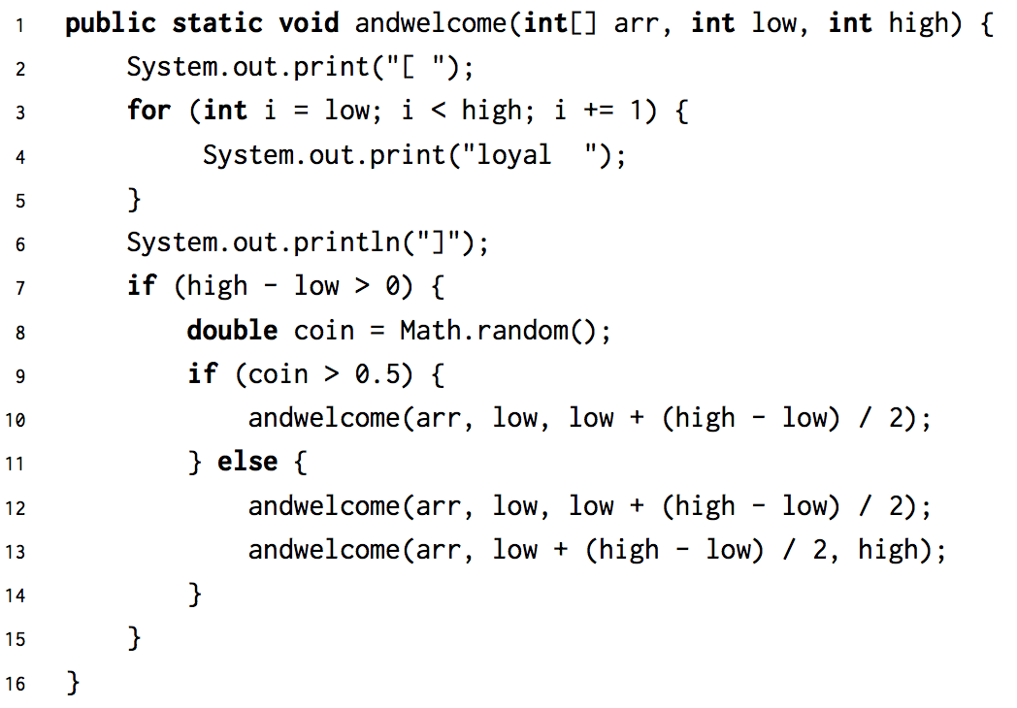
Problem 1.2

Slide 25
Problem 1.2
Θ(N log N)
Log n levels of work, but have a branching factor of 2 and each level is O(n) in the worst case

Slide 26
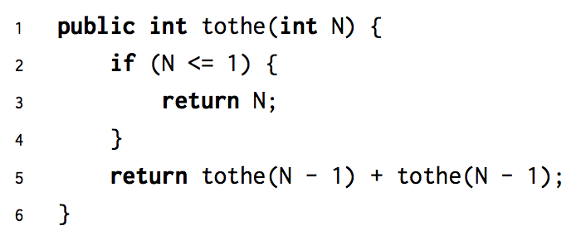
Problem 1.3

Slide 27
Problem 1.3
Θ(2^N)
2^i nodes per layer and each node does O(1) work

Slide 28
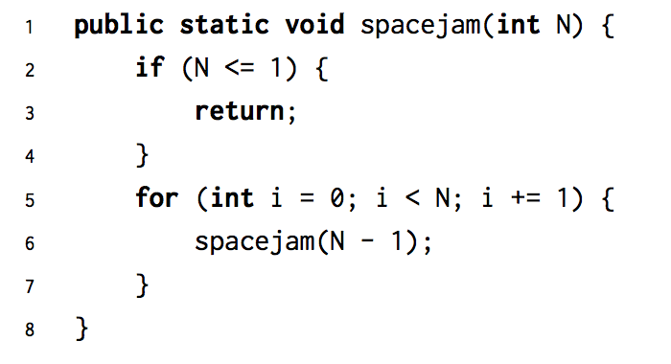
Problem 1.4

Slide 29
Problem 1.4
O(N * N!)
n-i work per node and n! / (n-i)! nodes per layer.

Slide 30
Problem 2.1
Don’t forget your definition for Ω , Θ, and O!

Slide 31
Problem 2.1
Algorithm 1
Neither
Neither
Algorithm 2
Neither

Slide 32
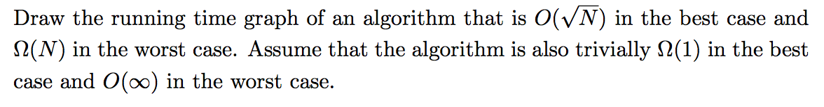
Problem 3.1

Slide 33
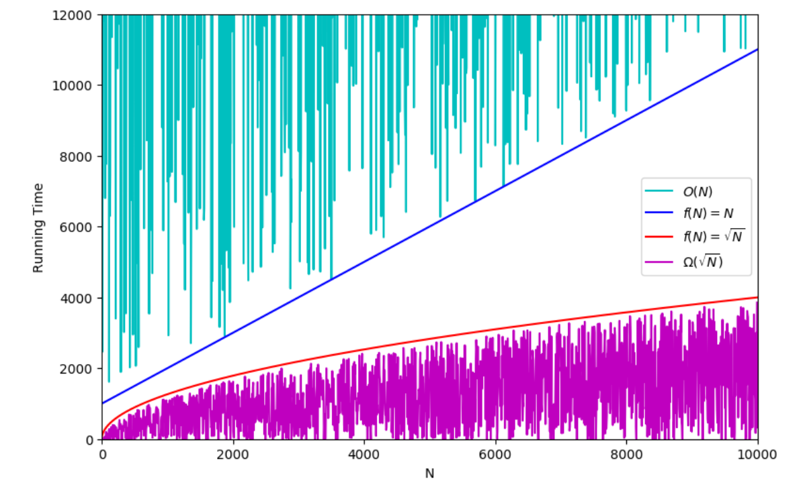
Problem 3.1

Slide 34
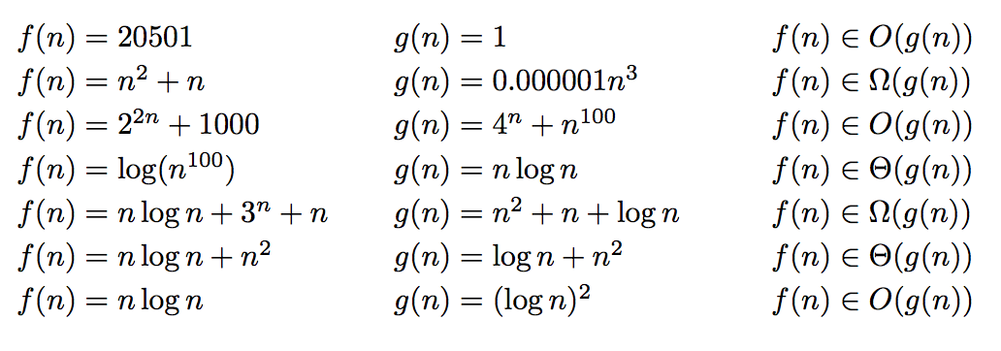
Problem 3.2: True or False?
Notes:
Teaching Goals: Understand that you can drop constants and ignore lower orders of growth, comparing different runtimes

Slide 35
Problem 3.2: True or False?
True
False
True
False
True
True
False

